Slide 1
Cotton in the Southwest Valley

Slide 2
We are the Litchfield Park Historical Society
THE LITCHFIELD PARK HISTORICAL SOCIETY'S MISSION STATEMENT
"To connect generations by fostering an understanding and appreciation of the history, arts, and culture of the Southwest Valley."
THE LITCHFIELD PARK HISTORICAL SOCIETY'S VISION STATEMENT
"To be the historical and cultural heart of the Southwest Valley."

Slide 3
Lesson Objectives
Cotton in the Southwest Valley
Students will learn how growing cotton impacted Arizona.
Students will identify major reasons why cotton growing developed in the Southwest Valley and Arizona.

Slide 4
Arizona Standards Addressed
Cotton in the Southwest Valley
This lesson has been designed to align with the following Arizona Third Grade Social Studies State Standards:
● 3.E1.1 Describe and discuss industries and occupations that have shaped Arizona.
● 3.G2.1 Explain how people modify and adapt to the Arizona environment.
● 3.G3.1 Describe the movement of people in and out of Arizona over time.
● 3.H3.2 Use primary and secondary sources to analyze the changes that have taken place in Arizona which could include the use of current events.

Slide 5
Essential Questions
Cotton in the Southwest Valley
How do events in other parts of the world make an impact in places far away?
What is the relationship between the characteristics of a place, such as geography and climate, and human activity in that place?

Slide 6
Vocabulary
Cotton in the Southwest Valley
Boll weevil: a small beetle with a gray body and a long snout. It lays eggs in the seed pods of the cotton plant where they hatch and cause much damage to crops.
Cotton: a plant that makes soft, white fibers which are used to make thread.
Durable: not easily broken or worn out.
Flexible: easily bent without breaking.
Long staple: having really long fibers.

Slide 7
Vocabulary
Cotton in the Southwest Valley
Resident: a person who lives in a particular place.
World War I: also called the Great War, this was a major war fought mostly in Europe between the Allies, which included France, Great Britain, and the United States and the Central Powers, which included Germany and Austria-Hungary. It was fought from 1914-1918 and ended with the collapse of of the Central Powers.

Slide 8
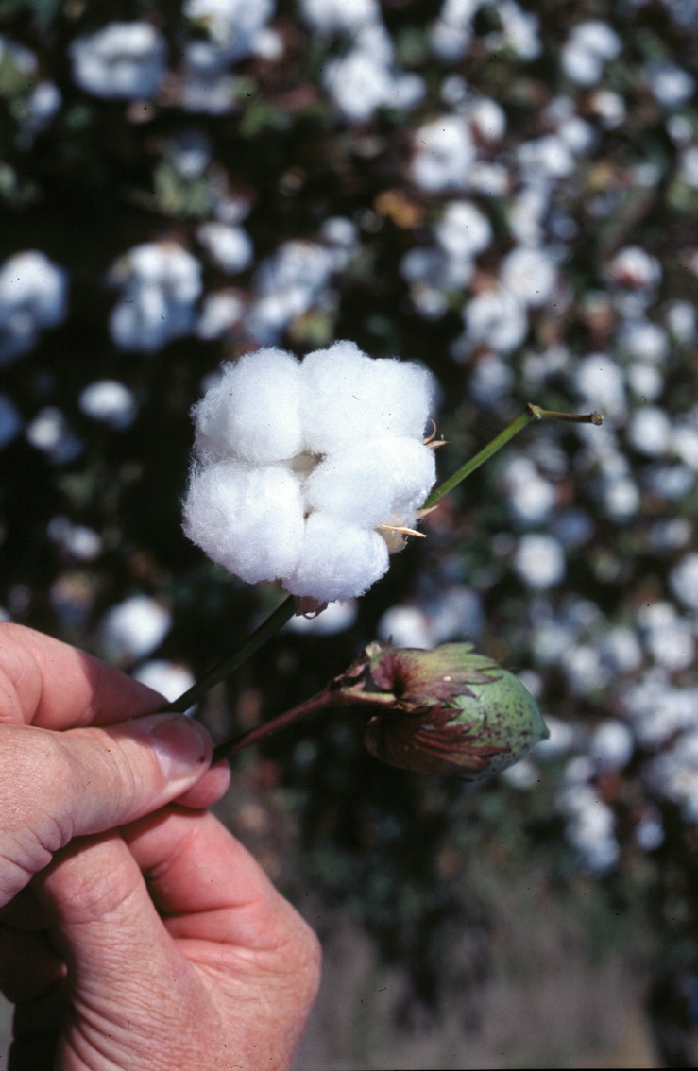
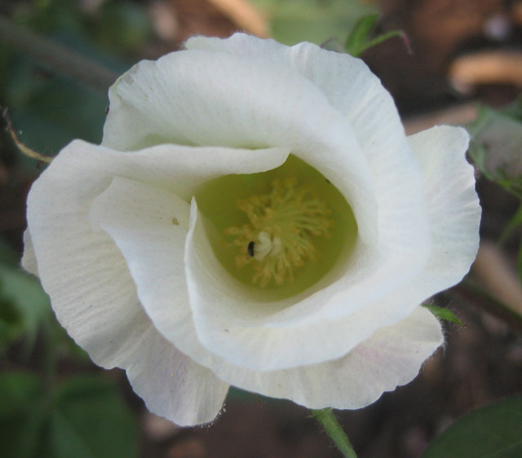
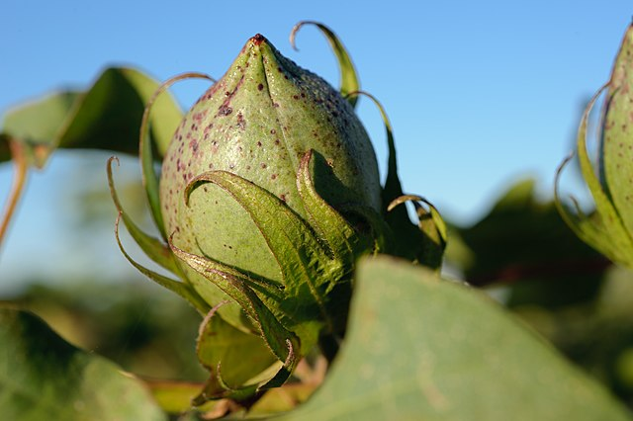
Warm Up
Cotton in the Southwest Valley
Can you think of anything made out of cotton?
Cotton comes from a plant.
This Photo by Unknown Author is licensed under CC BY-SA
This Photo by Unknown Author is licensed under CC BY-SA
This Photo by Unknown Author is licensed under CC BY

Slide 9
Instruction and Activity
Cotton in the Southwest Valley
We’re going to watch the video Cotton in the Southwest Valley.
As you watch the video, look for
reasons cotton became important in Arizona
the name of the person who decided to grow cotton in the Southwest Valley for a certain company
names and places in our surroundings today that have to do with cotton
https://www.youtube.com/watch?v=Q1EzfWWCTE0

Slide 10
Comprehension Check
Cotton in the Southwest Valley
Why did Paul Litchfield decide to grow lots of cotton in Arizona?
How did geography and climate influence this?
What are some things we can see today that remind us that growing cotton was important in the Salt River Valley in the past?
What things were included in the company town of Litchfield Park for the people who lived and worked there?

Slide 11
Extension Activity
Cotton in the Southwest Valley
Create and draw a map a town that relies on one of Arizona’s five Cs – copper, cattle, cotton, citrus, or climate.
What will your town produce?
Think about what the town needs for people to live there.
What will you provide for people to do for fun in their free time?
Will there be places for people to gather for community events?
What other jobs and businesses will the town need to make sure people have what they need?
Will there be doctors, schools, stores, community centers?
Where will people’s homes be located?
Provide reasons for your decisions to include certain things.
Think about the best places for your buildings and outdoor spaces.
Decide on a name for the town that reflects something about the town’s unique qualities.

Slide 12
Extension Activity
Cotton in the Southwest Valley
Teachers can explore other place names in Arizona with students with the online resources below.
Resources:
https://www.arizonahighways.com/classroom/arizona-place-names
https://www.azcentral.com/story/news/local/phoenix/2016/05/28/how-phoenix-area-cities-got-their-names/84467058/

